Slide 1
2. Parts of Speech Determining Part of Speech and problems with Traditional Definitions, the Major Parts of Speech- Nouns, Verbs, Adjectives, Adverbs. Open vs. Closed; Lexical vs. Functional words, Subcategories and features of Nouns and verbs
ENG467: Syntax and Structures of Language

Slide 2
Introduction
Let’s first look at the different kinds of words
the word's part of speech (also known as syntactic category or word class).
The most common parts of speech are nouns, verbs, adjectives, adverbs, and prepositions (also see pronouns, prepositions, conjunctions, articles/determiners)
Parts of speech tell us how a word is going to function in the sentence.

Slide 3
Consider the sentences in (1). Notice that we can substitute various words that are of the type
noun for the second word in the sentence:
1) a) The woman loved peanut butter cookies.
b) The puppy loved peanut butter cookies.
c) The queen loved peanut butter cookies.
However, we cannot substitute words that aren't nouns:
2) a) *The green loved peanut butter cookies.
b) *The in loved peanut butter cookies.
c) *The sing loved peanut butter cookies.
The same holds true for larger groups of words (the square brackets [ ... ] mark off the relevant
groups of words).
3) a) [Moises] went to the store.
b) [The man] went to the store.
c) *[Quickly walks] went to the store.

Slide 4
Determining Part of Speech
1.2 The Problem of Traditional Definitions
If you were taught any grammar in school, you may have been told that a noun is a "person, place, or thing", or that a verb is "an action, state, or state of being". Alas, this is a very over-simplistic way to characterize various parts of speech.
The first thing to notice about definitions like this is that they are based on semantic criteria.
4) The destruction of the city bothered the Mongols.
The meaning of destruction is not a "person, place, or thing". It is an action. By semantic criteria, this word should be a verb. But in fact, native speakers unanimously identify it as a noun.
5) a) Sincerity is an important quality.
b) the assassination of the president.
Sincerity is an attribute, a property normally associated with adjectives.
Yet in (5a), sincerity is a noun.
Similarly in (5b) assassination, an action, is functioning as a noun.

Slide 5
1.2 Distributional Criteria
The criteria we use for determining part of speech is NOT based on the meanings of the word,
but on its distribution.
We will use two kinds of distributional tests for determining part of speech:
morphological distribution and syntactic distribution.

Slide 6
1.2.1 Morphological distribution
First we look at morphological distribution; this refers to the kinds of affixes (prefixes and suffixes) and other morphology that appear on a word. Let's consider two different types of affixes.
First, we have affixes that make words out of other words. We call these affixes derivational morphemes.
These suffixes usually result in a different part of speech from the word they attach to.
For example, if we take the word distribute we can add the derivational suffix -(t)ion and we get the noun distribution. The -(t)ion affix thus creates nouns. Any word ending in -(t)ion is a noun. This is an example of a morphological distribution.
A similar example is found with the affix -al, which creates adjectives. If we take distribution, and add -al to it, we get the adjective distributional. The -al ending is a test for being an adjective.

Slide 7
The second is call inflectional morphemes
Derivational affixes make a word a particular category; by contrast inflectional morphemes don't make a word into a particular category, but instead only attach to certain categories.
Take for example the superlative suffix -est. This affix only attaches to words that are already adjectives: big, biggest (cf. dog, *doggest). Because they are sensitive to what category they attach to, inflectional suffixes can also serve as a test for determining part of speech category.

Slide 8
1.2.2 Syntactic distribution
The other kind of test we use for determining part of speech uses syntactic distribution. Syntactic distribution refers to what other words appear near the word. For example, nouns typically appear after determiners (articles) such as the, although they need not do so to be nouns. We can thus take appearance after the to be a test for noun­ hood.

Slide 9
The Major Parts of Speech- Nouns, Verbs, Adjectives, Adverbs.
Having determined that we are going to use distributional criteria for determining the part of speech of a word.
One thing that you'll notice is that these are specific to English. Every language will have its own distributional criteria.
Major parts of speech are noun (N), verb (V), adjective (Adj), and adverb (Adv).

Slide 10
2.1 Nouns
Derivational Suffixes: In English, nouns often end in derivational endings such as -ment (basement), -ness (friendliness), -ity (sincerity), -ty (certainty), -(t)ion (devotion), -ation (expectation), -ist (specialist), -ant (attendant), -ery (shrubbery), -ee (employee), -ship (hardship), -aire (billionaire), -acy (advocacy), -let (piglet), -ling (underling), -hood (neighborhood), -ism (socialism), -ing (fencing).
Inflectional Suffixes: Nouns in English don't show much inflection, but when pluralized
can take suffixes such as -s (cats), -es (glasses), -en (oxen), -ren (children),
Syntactic Distribution: Nouns often appear after determiners such as the, those, these
(e.g., these peanuts), and can appear after adjectives (the big peanut).
Nouns can also follow prepositions (in school).
All of these conditions can happen together (in the big gymnasium).
Nouns can appear as the subject of the sentence (Mary plucked the mango)

Slide 11
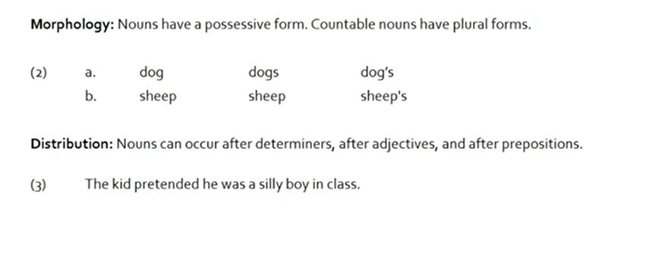

Slide 12
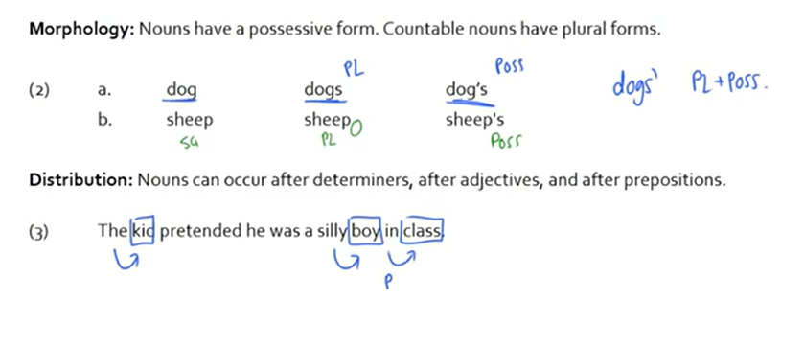

Slide 13
2.2 Verbs
Derivational Suffixes: Verbs often end in derivational endings such as –ate (dissipate), and -ize/-ise (regularize).
Inflectional Suffixes: In the past tense, verbs usually take an -ed or -t ending. In the present tense, third person singular (he, she, it), they usually take the -s ending. Verbs can also take an -ing ending in some aspectual constructions, (she was walking) and most take either an -en or an -ed suffix when they are passivized (more on passivization in later chapters): the ice cream was eaten.
Syntactic Distribution: Verbs can follow auxiliaries and modals such as will, have, having, had, has, am, be, been, being, is, are, were, was, would, can, could, shall, should, may, must, and the special non-finite marker to. Verbs follow subjects, and can follow adverbs such as often and frequently. Verbs can be negated with not.

Slide 14
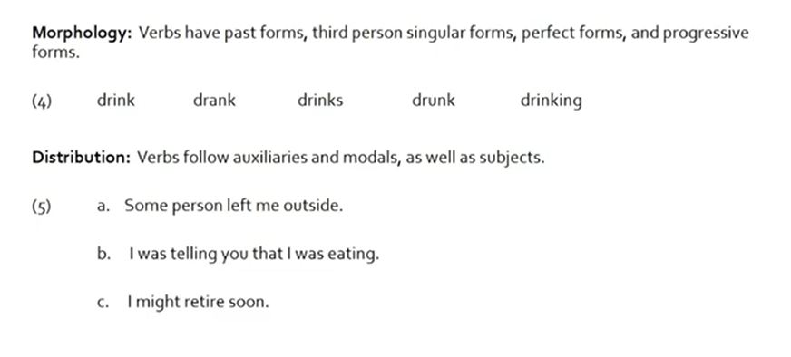

Slide 15
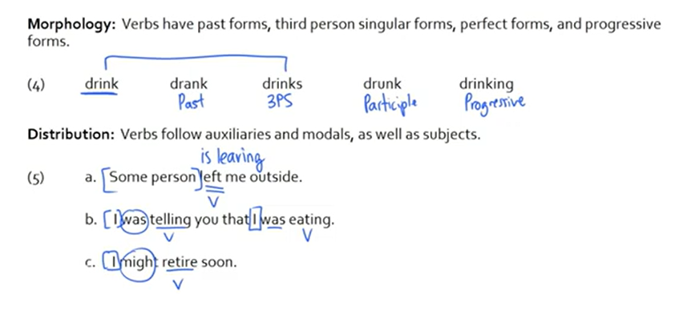

Slide 16
2.3 Adjectives
Derivational Suffixes: Adjectives often end in derivational endings such as -ing (the dancing cat), -ive (indicative), -able (readable), -al (traditional), -ate (intimate), -ish (childish), -some (tiresome), -(i)an (reptilian), -ful (wishful), -less (selfless), -ly (friendly).
Inflectional Suffixes: Adjectives can be inflected into a comparative form using -er (alternately they follow the word more). They can also be inflected into their superlative form using -est (alternately they follow the word most).
Syntactic Distribution: Adjectives can appear between determiners such as the, a, these, etc. and nouns (the big peanut). They also can follow the auxiliary am/is/are/was/were/be/been/being (warning: this distribution overlaps with verbs). Frequently, adjectives can be modified by the adverb very.

Slide 17
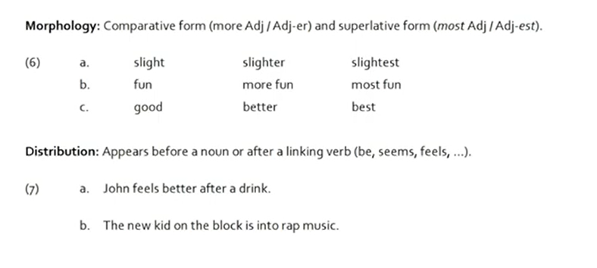

Slide 18
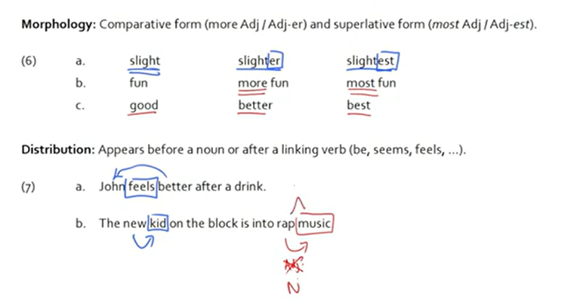

Slide 19
2.4 Adverbs
Derivational Suffixes: Many adverbs end in -ly: quickly, frequently, etc.
Inflectional Suffixes: Adverbs generally don’t take any inflectional suffixes. However, on rare occasions they can be used comparatively and follow the word more: She went more quickly than he did. Adverbs typically don’t take the prefix un- unless the adjective they are derived from does first
(e.g., unhelpfully from unhelpful, but *unquickly, *unquick).
Syntactic Distribution: The syntactic distribution of adverbs is most easily
described by stating where they can’t appear. Adverbs can’t appear between a determiner and a noun (*the quickly fox) or after the verb is and its variants. They can really appear pretty much anywhere else in the sentence, although typically they appear at either the beginning or the end of the clause/sentence. Frequently, like adjectives, they can be modified by the
adverb very.

Slide 20
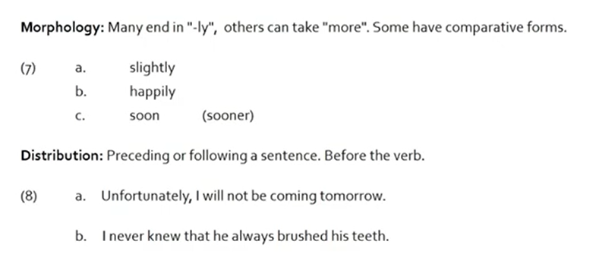

Slide 21
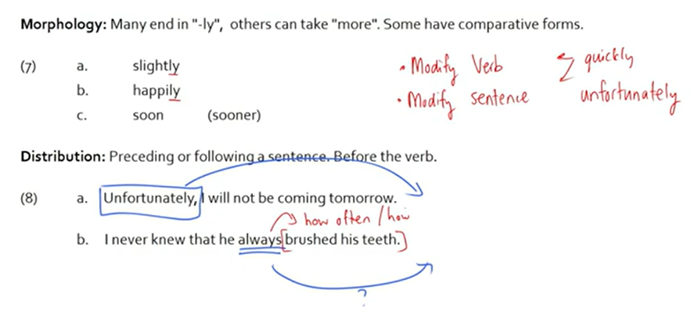

Slide 22
Prepositions and Determiners
Preposition Distribution: They occur before a noun.
It was a book written by John.
I want to go into the party.
Determiners distribution: They occur at the beginning of a noun phrase.
John remembers that this person knew every detail.
One person told me which doctor your brother liked.

Slide 23
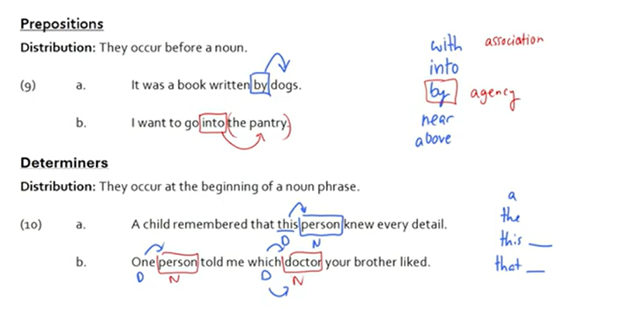

Slide 24
Conjunctions & Complementizers
Conjunctions distribution: They connect two of the same type of phrase..
[I was sleepy] but [I still tried my best].
I want neither [cats] nor [dogs].
Complementizer distribution: They occur at the beginning of a clause, allowing a clause
to be used as an argument.
I know [him].
I know [that he is watching me].
I know [whether he is watching me (or not)]

Slide 25
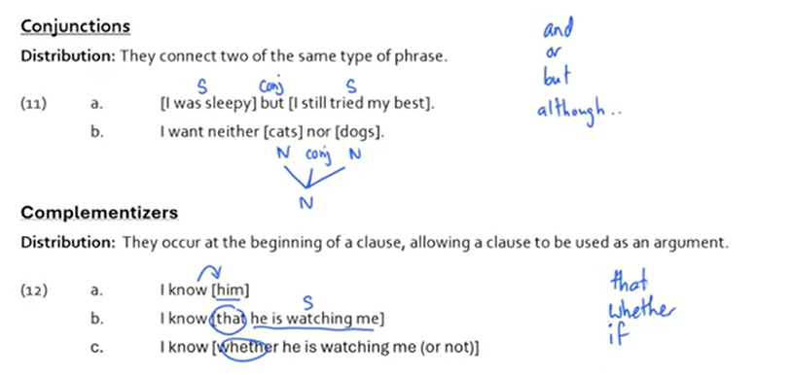

Slide 26
Auxiliaries & Modals
Auxiliaries distribution: They occur in the following order.
Perfect (have) > Progressive (be) > Passive (be) > verb
I have been sleeping.
I have slept.
I was awoken by John.
Modal distribution: They occur before any auxiliaries and the verb.
I could write a book.
I should be resting.
I might have been too mean.

Slide 27
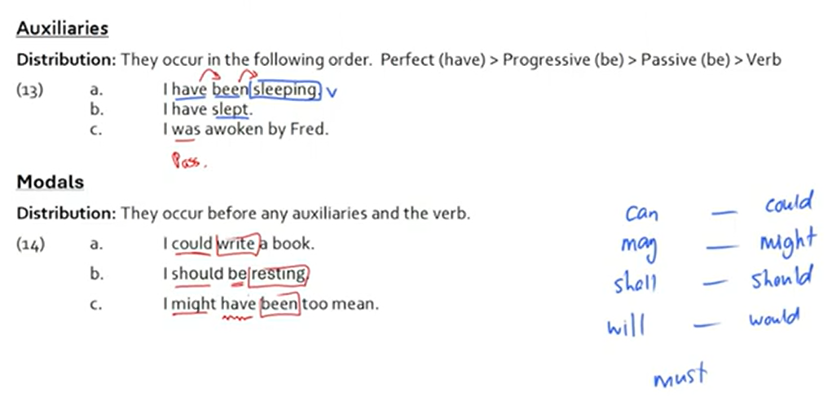

Slide 28
Word Class
Words are fundamental units in every sentence, so we will begin by looking at these. Consider the words in the following sentence: my brother drives a big car
We can tell almost instinctively that brother and car are the same type of word (Noun),
and also that brother and drives are different types of words (Different word category).
By this we mean that brother and car belong to the same word class (Noun).
Similarly, when we recognise that brother and drives are different types, we mean that they belong to different word classes.

Slide 29
Definition of Word classes
The words in a language are organized into different Categories.
In traditional terms, they are called parts of speech and
In modern terms, word classes.
Word class is a group of words which are similiar in function.
Words are grouped into word classes according to
how they combine with others words,
how they change their form.

Slide 30
Open word vs. Closed word Parts of Speech
Some parts of speech allow you to add affixes or new words,
While some parts of speech does not allow adding of affixes or new words.
Based on this, parts of speech can be classified into two:
Open Class vs. Closed Class Parts of Speech

Slide 31
Open-class word
Also called lexical or content words or major word class, these words are flexible and allow adding new words as the need arises. They include nouns, verbs, adjectives, and adverbs. For example, new nouns are created every day.
Egs: dog, dogs; black+box = blackbox
play, player, plays, playing
tall, taller, tallest
Open-class words comprise a large portion of any language.
Unlike closed-class words, which are finite, the possibility of creating and adding new words to an open word-class is practically infinite.
Open class words are further divided into two: simple and complex words.
A simple word only has one morpheme. For example, swim, green, and house only have one morpheme.
A complex word has more than one morpheme. Some examples include swimming, greenest, and houses.

Slide 32
Closed-class word
Closed word class or minor word classes include pronouns, determiners (article, demonstratives, etc.), prepositions, conjunctions, interjections.
Closed Class Words | Examples
Pronoun | you, me, she, them, some, it, us
Determiner | the, a, an, this, that, some, any, all
Preposition | in, of, on, at, to, under, from
Conjunction | and, but, or, if...then, although
Interjection | oh, ah, ugh, hey

Slide 33
Difference between Open class word and Closed class word
Open classes have a very large number of members. Every language has a large number of nouns, verbs, adjectives and adverbs. The Closed classes, on the other hand, are highly restricted in their membership.
The number of members of Open classes in a language in always increasing. New words are formed to suit the ever increasing needs of the community and new words are also borrowed from other language communities. On the other hand, the number of words in Closed classes remains more or less fixed.

Slide 34
Lexical vs. Functional
The Open Word class and Closed Word class distinction is similar to (but not identical to) another useful distinction in parts of speech.
This is the distinction between Lexical and Functional parts of speech.
Notes:
The related distinction between
The Open Class word vs Closed Class word
Lexical and Functional categories,
Content word and Function words.

Slide 35
Lexical words
Lexical words provide the "content" of the sentence.
They carry a concrete meaning.
It means they have clear meanings that you could describe to someone.
Nouns, verbs, adjectives, and adverbs are all lexical parts of speech.
And they are all open classes of words, that is to say, affixes can be added to them.
Lexical words are crucial to understand the meaning of a text or piece of information. Even if you leave out all the other words and keep just the lexical words, the meaning will be understandable.

Slide 36
This is often used in headlines or telegrams. Here’s an example of a headline:
Missing Link Found in Australia
As you can see the above sentence, most of the function words have been removed and only the lexical ones have been maintained. Still, the meaning is clear..
Notes:
The related distinction between
The Open Class word vs Closed Class word
Lexical and Functional categories,
Content word and Function words.

Slide 37
Functional words
Functional or grammatical categories include determiners, prepositions, complementizers, conjunctions, negation, auxiliaries, and modals, affixes.
They do not carry a meaning themselves.
They bind lexical words and create relationships between them in a sentence. They also help you interpret lexical words in a text or sentence.
They provide the grammatical information in a sentence.
They are words that exist to explain or create grammatical or structural relationships
into which the content words may fit in the sentence.
Notes:
The related distinction between
The Open Class word vs Closed Class word
Lexical and Functional categories,
Content word and Function words.

Slide 38
Difference between Lexical and Functional categories
All words in the dictionary or those used by native speakers of English are lexical words or morphemes. But words such as pronouns, prepositions, conjunctions, and determiners (a, an, the, some, many. any, etc.) are always grammatical words or morphemes.
Lexical words are huge in number and get constantly added over time, whereas the number of grammatical words or morphemes remains constant because they are functional words.
For example, words like ‘ipad’, ‘iphone’, ‘missile, etc. weren’t in use many decades ago.
How many new grammatical words have been added in English? None. This is the difference. Also, all inflections (-al, -ly, -ic, -er, -en, etc.) are grammatical morphemes.

Slide 39
feature | lexical words | function words
number | There’s an unlimited number of lexical words, because they belong to the open classes. | There’s a limited and relatively small number of function words, because they belong to the closed classes.
length | Lexical words may be of any length. | Most function words are short.
frequency | Lexical words occur with low frequencies. Some of them only occur in specialized texts. | They occur frequently in any text. Some occur more frequently than others, though.
lexical meaning | Lexical words carry a meaning. | Function words don’t have a lexical meaning.
morphology | Lexical words are variable. They can be inflected. | Function words are invariable.
stress | Lexical words usually carry the primary or secondary stress. | Function words are usually unstressed and often reduced.
role in phrase | Lexical words can be the heads of phrases. | Function words are never the heads of phrases.

Slide 40
Some Functional (Closed) Categories of English
Let’s see the functional categories of English.

Slide 41
1. Determiners
The class of determiners (D) is a little broader. It contains a number of subcategories
including articles, quantifiers, numerals, deictics, and possessive pronouns. Determiners
appear at the very beginning of English noun phrases.
Determiners of English (D)
Articles: the, a, an
Deictic articles: this, that, these, those, yon
Quantifiers: every, some, many, most, few, all, each, any, less, fewer, no
(Cardinal) numerals: one, two, three, four, etc.
Possessive pronouns: my, your, his, her, its, our, their
Some wh-question words: which, whose

Slide 42
2. Preposition (P):
Prepositions appear before nouns (or more precisely, noun phrases). English prepositions include the following:
Prepositions of English (P): to, from, under, over, with, by, at, above, before, after, through, near, on, off, for, in, into, of, during, across, without, since, until.

Slide 43
3. Complementizers:
The class of complementizers (C) also connects structures together, but they embed one clause inside of another instead of keeping them on an equal level:
Complementizers of English (C): that, for, if, whether

Slide 44
4. Conjunctions:
Conjunctions (Conj) are words that connect two or more phrases together on an equal level:
Conjunctions of English (Conj): and, or, nor, neither ... nor, either ... or

Slide 45
5. Tense:
One of the most important categories that we'll use is the category of tense (T).
For the moment we will not include tense suffixes such as -ed and -s in this class, and treat those as parts of verbs.
Instead, the category T consists of auxiliaries, modals, and the non-finite tense marker. In the older syntactic literature, the category T is sometimes called Infl (inflection) or Aux (Auxiliary).
Tense categories of English (T) .
Auxiliaries: have/has/had, am/is/ are/was/were, do/ does/ did
Modals: will, would, shall, should, can, could, may, might, must
Non-finite tense marker: to

Slide 46
Subcategories and features of Nouns and verbs
Each major part of speech category may have subtypes.
For example, we listed six different kinds of D (articles, demonstrative, quantifiers) and three kinds of T (auxiliaries, modals, and the non-finite marker).
The technical term for these subtypes is subcategories.
But we shall be looking at the subcategories and features of Nouns and Verbs.
Because one way to mark subcategories is through the use of features.

Slide 47
One way to mark subcategories is through the use of features.
Consider the case of T (tense).
To distinguish among the subcategories we can appeal to the features [±modal] and [±non-finite]:
1) Auxiliary T[–modal, –nonfinite]
Modal T[+modal, –nonfinite]
to T[+modal, +nonfinite]
We might similarly distinguish among tense forms using features like
[±past] etc. So was is [+past]; is is [-past] etc.

Slide 48
Subcategories of Nouns
Nouns can be divided into different subcategories.
We shall see some basic subcategories:
plural vs. singular, proper vs. common noun, count vs. mass noun,
pronoun vs anaphors

Slide 49
Singular vs plural noun distinction
First let’s distinguish along the line of plurality.
English nouns can be either singular or plural.
The distinction between singular and plural is usually morphologically marked with one of the plural endings like -s or -es (although it need not be, as in sheep or deer). Most singular nouns in English require a Determiner; plural ones do not require a Determiner, although they allow one:
2) a) *Cat ate the spider.
b) The cat ate the spider.
c) Cats ate the spider.
d) The cats ate the spider.
We mark this distinction with the feature [±PLURAL].

Slide 50
Count vs. Mass noun distinction
Count nouns represent individual, “countable” elements.
For example, apple is a count noun.
“Mass nouns” usually can’t be counted in the same way.
For example sincerity and air are mass nouns. There are two easy distributional tests to distinguish between mass and count nouns.
Mass nouns take the quantifier much, while count nouns take many.
3) a) many apples
b) *much apples/apple11
c) *many sincerity
d) *many air
e) much sincerity
f) much air

Slide 51
Like plurals, mass nouns generally don’t require a determiner, but count nouns do:
4) *I ate apple.
I ate the (an) apple.
I ate sugar.
I ate the sugar.
He is filled with sincerity.
I doubt his sincerity.
We distinguish between count and mass nouns using the feature [±count].

Slide 52
Proper names and common nouns
Proper nouns are the names of specific individuals, things, places, companies, etc. People: John, Mary
Places: London, Delhi
Things: The Statue of Liberty
Common nouns are general: they usually name classes of things, people, and places rather than specific things, people, and places.
Proper nouns are not modified by determiners (*the John)
But common nouns can be modified by determiners (the dog)
There are some exceptions to this generalization. Eg. when referring to a family it’s common to say the Ambanis.

Slide 53
However, in other languages, proper names can take determiners.
For example, in some dialects of Spanish,
it is okay to say La Rosamaria “the Rosemary”.
If necessary, we can distinguish proper names from common nouns using the feature [±PROPER], although this feature is less useful than the others.

Slide 54
Common Nouns can be subdivided into Countable and Uncountable
NOUN
Common noun Proper noun
Countable Uncountable noun Animate Inanimate
Animate Inanimate Human Non-human Egypt
Human Non-human book John Fido (pet)
Boy dog
Abstract Concrete
Lacking SG Lacking PL Lacking SG Lacking PL
Congratulations goodness Animate Inanimate copper
Thanks shame Human Non-human goods wheat
(Good) wishes police cattle particulars
(Best) wishes people vamin remains
valuables
Notes:
Concrete nouns are perceivable objects in the world.
Abstract nouns refers to idea, feelings, quality: truth, honesty, kindness, action: movements, activity, theft, mischief, state: infancy, childhood, adolescence, names of various arts, sciences and professions: economics, politics, history, music, etc.

Slide 55
Pronouns and anaphors vs Lexical nouns
These classes differ from the others in that they are closed word class.
They never allow determiners or adjectival modification.
5) a) he b) himself
c) *the he d) *the himself
e) *big he f) *big himself
Pronouns belong to the class [+PRONOUN, –ANAPHOR].
Anaphors are [+PRONOUN, +ANAPHOR].
All other nouns are [–PRONOUN, –ANAPHOR].

Slide 56
Subcategories of Verbs
There are two major ways in which we can divide up verbs into subcategories. One is along the lines of tense/finiteness
(i.e., whether the verb is left, leaves, (will) leave or (to) leave).
The other way is in terms of the number of noun phrases (NPs) and prepositional phrases (PPs) or clauses (CPs) they require. This second kind of division is known as argument structure.

Slide 57
first we need to define some basic terms.
In school grammar we might have learnt that “every sentence has a subject and a predicate.”
This would mean that the subject is usually the first noun phrase (that is, the first noun and all things that go along with it), and the predicate is everything else in the sentence.
So for example, in (6) the subject is the dastardly phonologist, and the predicate would be stole the syntactician’s lunch.
6) [The dastardly phonologist][stole the syntactician’s lunch].
subject predicate (traditional definitions)

Slide 58
But in syntax, predicate is based on the mathematical notion of a “relation”.
The predicate defines the relation between the individuals being talked about and the real world – as well as among themselves. The entities (which can be abstract) participating in the relation are called arguments.

Slide 59
To see how this works, look at the following example:
7) John hit the baseball.
There are two arguments in this example, John and the baseball.
These are elements in the world that are participants in the action described by the sentence.
The predicate here is hit. Hit expresses a relation between the two arguments: more precisely, it indicates that the first argument (John) is applying some force on the second argument (the baseball). This may seem patently self-evident, but it’s important to understand what is going on here on an abstract level. This usage of the terms predicate and argument is identical to how they are used in formal logic.

Slide 60
We can speak about any particular predicate’s argument structure.
This refers to the number of arguments that a particular predicate requires.
Another name for argument structure is valency.
The word Take, for example, predicates that take only one argument (i.e., they have a valency of 1). These are predicates like smile, arrive, sit, run, etc.
The property of transitivity refers to how many arguments follow the verb. In predicates with a valency of 1, no arguments follow the verb (the single argument precedes the verb),
So these predicates are said to be intransitive verbs.

Slide 61
Predicates that take two obligatory arguments have a valency of 2;
Some examples are hit, love, see, kiss, admire, etc.
These predicates are said to be transitive, because they have a single argument after the verb (the other argument precedes the verb).
Finally predicates that take three arguments have a valency of 3.
Put and give are the best examples of this class.
These predicates have two arguments after the verb so are said to be ditransitive verbs.

Slide 62
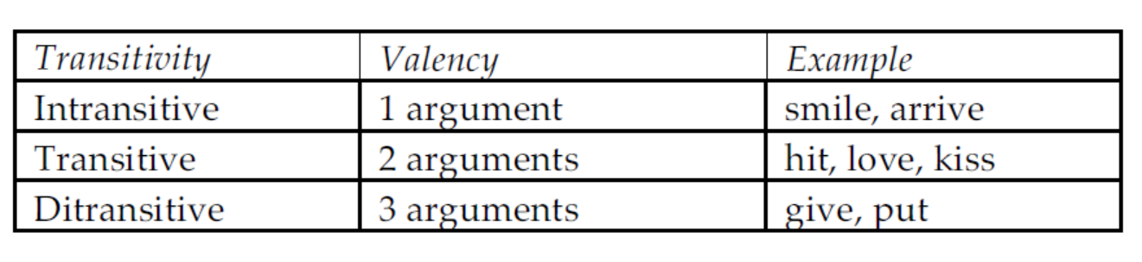
In determining how many arguments a predicate has, we only consider the obligatory NPs and PPs. Optional ones are never counted in the list of arguments. Only obligatory elements are considered arguments.

Slide 63
Predicates not only restrict the number of arguments that appear with them, they also restrict the categories of those arguments.
A verb like ask can take either an NP or a clause (embedded sentence = CP) as a complement:
8) a) I asked [_{NP} the question].
b) I asked [_{CP} if you knew the answer].
But a verb like hit can only take an NP complement:
9) a) I hit [_{NP} the ball].
b)*I hit [_{CP} that you knew the answer].

Slide 64
With these basics in mind, we can set up a series of features based on how many and what kind of arguments a verb takes.
Let’s start with intransitives. These require a single NP subject. We’ll mark this with the feature [NP__] where the underscore represents where the verb would go in the sentence. An example of such a verb would be leave, sleep, cough.
Examples of intransitive sentences (Subject and Verb only):
John slept.
Peter ran quickly.
She left already.

Slide 65
Most transitive verbs require an NP object, so we can mark these with the feature [NP___NP].
An example of this is the verb hit.
10) a) I hit [_{NP} the ball].
Verbs like ask, think, say, etc. allow either an NP object or a CP (embedded clause) object.
11) a) I asked [_{NP} the question].
b) I asked [_{CP} if you knew the answer].
We can mark this using curly brackets {} and a slash. {NP/CP} means “a choice of NP or CP”.
So the feature structure for predicates like this is [NP___{NP/CP}].

Slide 66
Ditransitive verbs come in several major types.
Some ditransitives require two NP objects (the first is an indirect object, the other a direct object).
The verb spare is of this category. It does not allow an NP and a PP:
12) a) I spared [_{NP} him] [_{NP} the trouble].
b) *I spared [_{NP} the trouble] [_{PP} to him].
This category of ditransitive is marked with the feature [NP_____NP NP].

Slide 67
The opposite kind of ditransitive is found with the verb put.
Put requires an NP and a PP:
13) a) *I put [_{NP} the box] [_{NP} the book].
b) I put [_{NP} the book] [_{PP} in the box].
This kind of ditransitive takes the feature [NP ____ NP PP].

Slide 68
We also have ditransitives that appear to be a combination of these two types and allow either an NP or a PP in the second position:
14) a) I gave [_{NP} the box] [_{PP} to Leah].
b) I gave [_{NP} Leah] [_{NP} the box].
These have the feature [NP ___ NP {NP/PP}].

Slide 69
Finally we have ditransitives that take either two NPs, or one NP and one CP, or an NP and a PP:
15) a) I told [_{NP} Daniel] [_{NP} the story].
b) I told [_{NP} Daniel] [_{CP} that the exam was cancelled].
c) I told [_{NP} the story] [_{PP} to Daniel].
Verbs like tell have the feature [NP_____ NP {NP/PP/CP}].

Slide 70
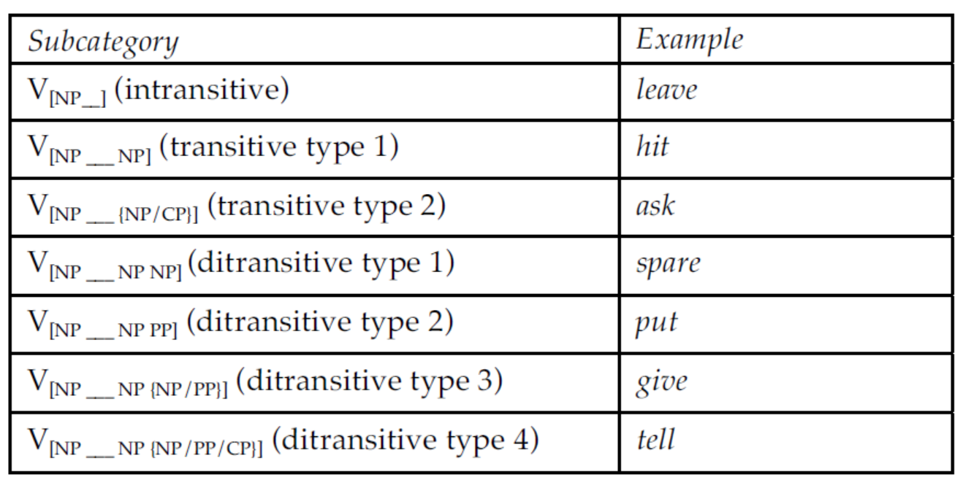
The following chart summarizes all the different subcategories of verb we’ve discussed here:

Slide 71
Summing up the ideas covered
Parts of Speech (a.k.a. Word Class, Syntactic Categories): The labels we give to constituents (N, V, Adj, Adv, D, P, T, Conj). These determine the position of the word in the sentence.
Distribution: Parts of speech are determined based on their distribution. We have both morphological distribution (what affixes are found on the word) and syntactic distribution (what other words are nearby).
Complementary Distribution: When you have two categories and they never appear in the same environment (context), you have complementary distribution. Typically complementary distribution means that the two categories are subtypes of a larger class.

Slide 72
Parts of speech that are Open Class can take new members or coinages: N, V, Adj, Adv.
Parts of speech that are Closed Class don’t allow new coinages: D, P, Conj, C, T, Neg, and the pronoun and anaphor subcategories of N.
Lexical Categories express the content of the sentence. N (including pronouns), V, Adj, Adv.
Functional Categories contain the grammatical information in a sentence: D, P, Conj, T, Neg, C.

Slide 73
Subcategories: The major parts of speech can often be divided up into subtypes. These are called subcategories.
Feature Notations on major categories are a mechanism for indicating subcategories.
Plurality refers to the number of nouns. It is usually indicated in English with an -s suffix. Plural nouns in English do not require a determiner.
Count vs. Mass: Count nouns can appear with determiners and the quantifier many. Mass nouns appear with much and usually don’t have articles.

Slide 74
The Predicate defines the relation between the individuals being talked about and some fact about them, as well as relations among the arguments.
Argument Structure: The number of arguments that a predicate takes.
The Arguments are the entities that are participating in the predicate relation.
Intransitive: A predicate that takes only one argument.
Transitive: A predicate that takes two arguments.
Ditransitive: A predicate that takes three arguments.

Slide 75
Summing up
Distinguish between distributional and semantic definitions of parts of speech.
Identify a part of speech by its distribution.
Know the difference between an open-class and a closed-class part of speech.
Explain the difference between lexical and functional categories.
Identify different subcategories using feature notations.
Identify plural nouns, mass nouns and distinguish them with features.
Explain the difference between predicates and arguments.
Categorize verbs according to their argument structure (intransitive, transitive, ditransitive) and represent this using features.

Slide 76
Problem Sets

Slide 77
EX. 1: Identify the main parts of speech (i.e., Nouns, Verbs, Adjectives/Adverbs,
and Prepositions) in the following sentences. Treat hyphenated words as single words:
a) The old rusty pot-belly stove has been replaced.
b)The red-haired assistant put the vital documents through the new efficient
shredder.
c)The large evil leathery alligator complained to his aging keeper about his extremely
unattractive description.
d) I just ate the last piece of chocolate cake.

Slide 78
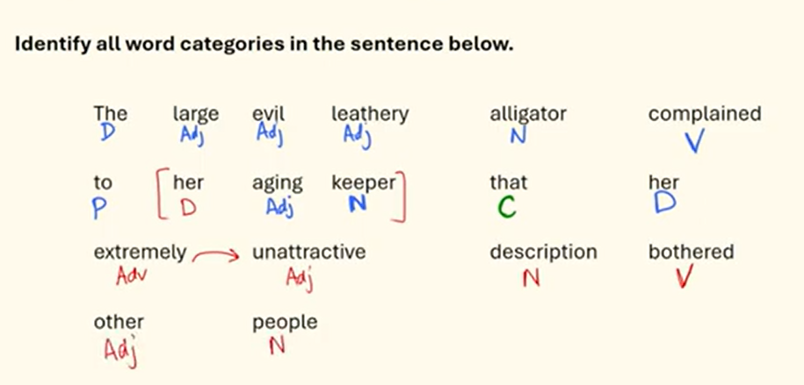
Exercise 2

Slide 79
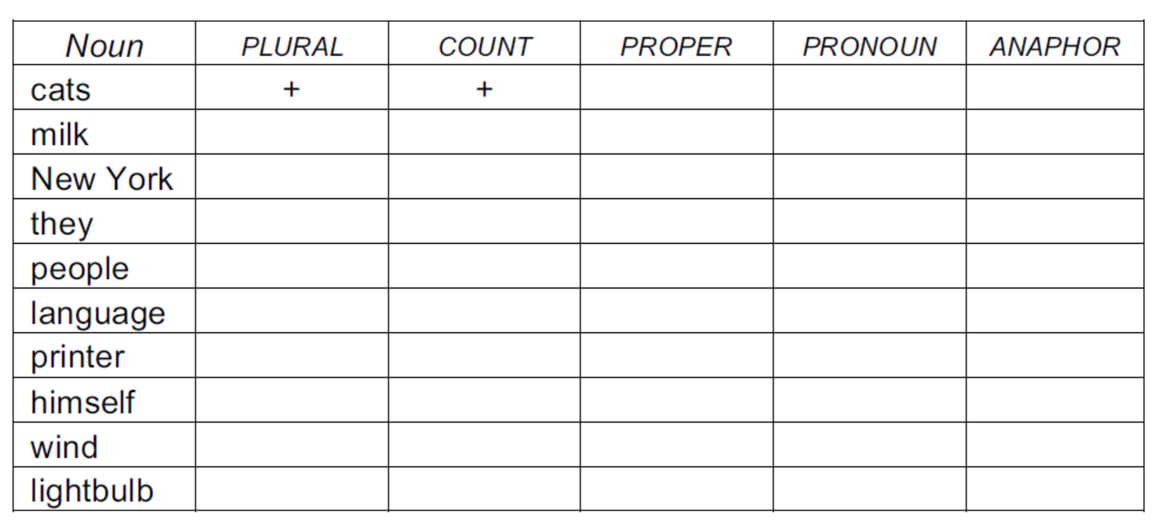
EX. 3: SUBCATEGORIES OF NOUNS
For each of the nouns below put a + sign in the box under the features that they have. Note that some nouns might have a plus value for more than one feature. The first one is done for you. Do not mark the minus (–) values, or the values for which the word is not specified; mark only the plus values!

Slide 80
EX. 4: SUBCATEGORIES OF VERBS
For each of the verbs below, list whether it is intransitive, transitive or ditransitive and list which features it takes. In some cases they may allow more than one feature (e.g., the verb eat is both [NP__NP] and [NP ]). Give an example for each feature:
spray, sleep, escape, throw, wipe, say, think, begrudge (or
grudge), thank, pour, send, promise, kiss, arrive

Slide 81
References
Carnie, A. (2021). Syntax: A Generative Introduction (Fourth Edition). Wiley Blackwell.
Thakur, D. (1998). Linguistics Simplified Syntax. Bharati Bhawan.
3. https://prosperoenglish.com/posts/grammar/lexical-words-function-words-inserts/

